Slide 1
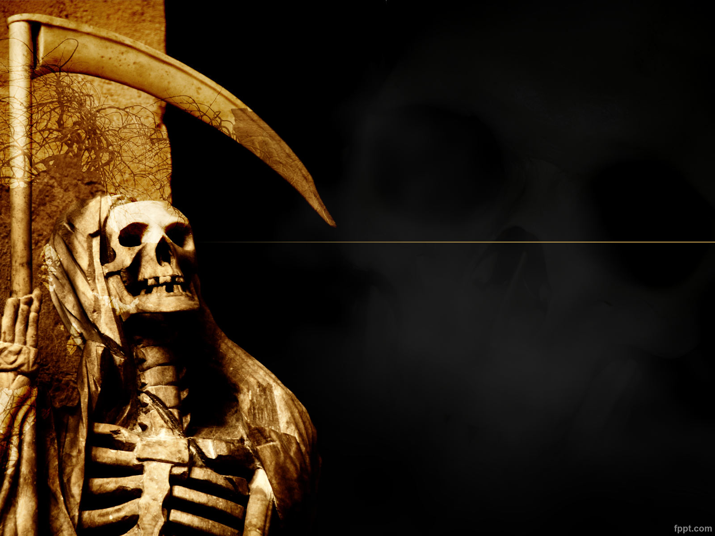
Prepared By Pankaj KC
APPLICATION OF PATTERN RECOGNITION

Slide 2
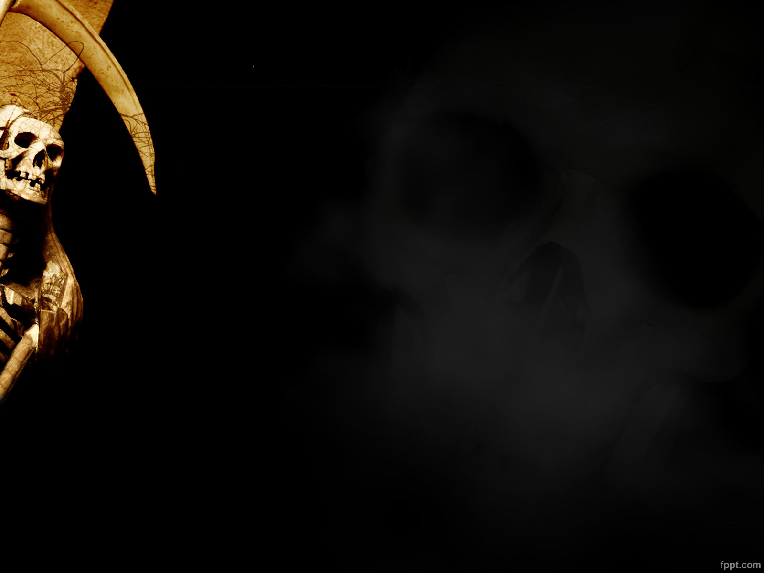
Ultimate Use
Pattern recognition is used in any area of science and engineering that studies the structure of observations.

Slide 3
Use
It is now frequently used in many applications in manufacturing industry, healthcare, and the military.

Slide 4
Examples include the following
Optical character recognition (OCR) is becoming an integral part of document scanners, and is also used frequently in banking and postal applications. Printed characters can now be accurately recognized, and the improving performance of automatic recognition of handwritten cursive characters has diminished significantly the need of human interaction for OCR tasks.

Slide 5
Character recognition
Automated mail sorting, processing bank checks; Scanner captures an image of the text; Image is converted into constituent characters. Eg: Application-Techcandy, google Translate, Zamzar etc.
Speech recognition
Human computer interaction, Universal access; Microphone records acoustic signal; Speech signal is classified into phonemes and words. Eg:Siri etc.

Slide 6
Other Applications
Safety
-Face recognition
-Identifying fingerprints
Astronomy
-Classifying galaxies by shape
- Astronomical telescope image analysis
-Automatic spectroscopy
Bioinformatics
-DNA sequences analysis
-DNA micro array data analysis->research of heredity.

Slide 7
Other Applications Cont…….
Agriculture Output analysis Soil evaluating
- Extraction mineral characterization in coffee and sugar
Geography
- Earthquake analysis Rocks classification
Engineering
Fault diagnosis for vehicle system
Recognition of automobile Type
Improve the safety performance of automobile
Military affairs
-Aviation photography analysis
-Automatism Aim recognition

Slide 8
Reference:
Paper
Pattern Recognition: an Overview
10.5923.j.ajis.20120201.04

